Slide 1
The POLIO STORY
Kaiqiong Zhao

Slide 2
Outline
~20-minute video with clips from
The polio story – the vaccine that changed the world (44 mins- BBC)
The last mile and Tommy Francis (16 mins -U of Michigan )
A quick look at the biggest-ever public health experiment
Polio in 2016

Slide 3
video

Slide 4
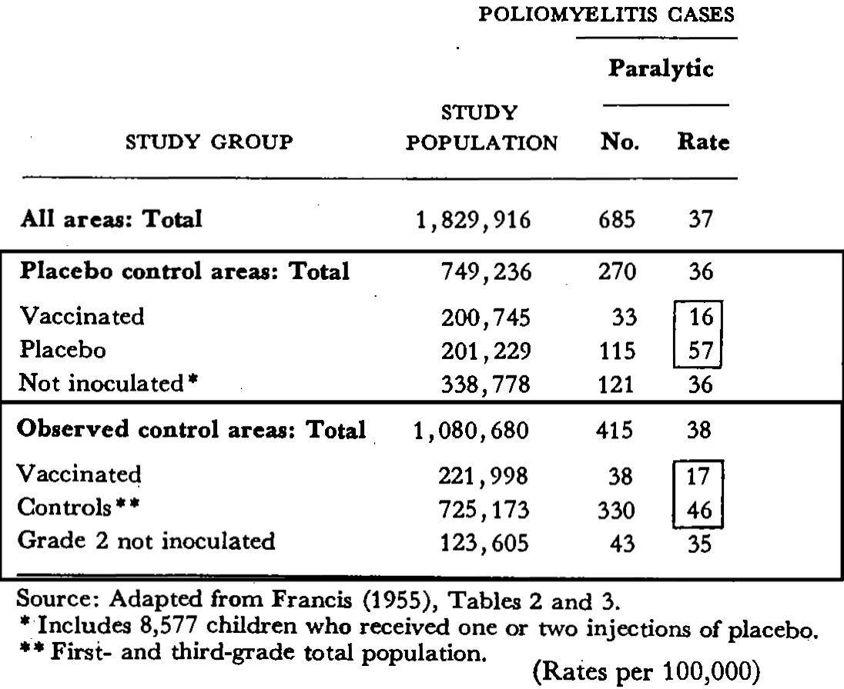

Slide 5
Polio in 2016
Government of Nigeria reports 2 wild polio cases, first since July 2014, (11 AUGUST 2016)
Globally, the world is very close to reaching the goal of polio eradication. Only 21 wild polio cases have been reported so far (August) in 2016, compared to 34 cases at the same point last year. Only 2 other countries are reporting polio: Pakistan and Afghanistan. Four out of the 6 WHO Regions of the world have been certified polio-free, and only one of the three types of wild poliovirus is still circulating in the world (type 1).

Slide 6
THANKS

